Slide 1
BALOON NATIONAL HACKATHON 2026
CareRelay
Dialysis care and
transport coordination
Round 1: PPT & Prototype Submission
Open the working prototype
https://carerelay-dialysis-continuity.amplewand1.chatgpt.site/judge-demo
Aadithya Ram
Abhishek Bharathi
Notes:
Current CareRelay MVP design and repository evidence. Simulated records do not represent real bookings or clinical outcomes.

Slide 2
Own Problem Statement & Proposed Solution
A replacement appointment needs a complete journey
Problem statement: help patients reach suitable dialysis when their usual arrangement falls through.
2.2 lakh
3.4 crore
new ESRD patients each year in India
additional dialysis sessions needed annually
A missed treatment can allow fluid, potassium and waste to build up.
Finding a staffed machine is only useful when a suitable journey can reach it in time.
Sources: MoHFW PMNDP estimates and National Kidney Foundation. Need estimates, not project outcomes.
CareRelay / Baloon National Hackathon 2026 / Round 1
02
Notes:
Sources: Ministry of Health and Family Welfare, PMNDP, https://pmndp.mohfw.gov.in/en, accessed 20 October 2026. Its estimates are about 2.2 lakh new ESRD patients and an additional 3.4 crore dialysis sessions annually. National Kidney Foundation, https://www.kidney.org/kidney-topics/hemodialysis, explains that missed treatments can allow fluid, potassium and waste to build up. These figures describe need, not CareRelay adoption or outcomes.

Slide 3
Own Problem Statement & Proposed Solution
One request for treatment, transport or both
CareRelay coordinates provider capacity and a feasible journey through a human-reviewed plan.
Patient or caregiver
Care coordinator
Registers once, then submits a dated request with a reason, preferred time and accessibility needs.
Reviews membership separately, verifies request requirements and approves a suitable arrangement.
Hospital or dialysis centre
Transport partner
Publishes machine identifiers and staffed slots, then accepts the assigned treatment.
Reports availability and vehicle suitability, then confirms the pickup and assistance.
Target users: people needing replacement dialysis access and the teams helping them reach it.
CareRelay / Baloon National Hackathon 2026 / Round 1
03
Notes:
Current CareRelay MVP design and repository evidence. Simulated records do not represent real bookings or clinical outcomes.

Slide 4
Key Features & Technology Stack
The workflow covers the whole care episode
Implemented MVP features, demonstrated with fictional accounts and simulated providers.
Clear entry and requests
Capacity and matching
Separate membership applications and appointment requests. Treatment only, transport only and combined support.
Editable machine slots and vehicle availability. Ranked manual selection, individual suggestions and bulk approval.
Provider handover
Follow-through and support
Exact appointment machine and slot for hospitals. Pickup, contact and accessibility details for drivers.
Provider confirmations, patient journey milestones, completed history and an authorized shared inbox.
Maps support place discovery. Only provider-reported capacity supports an arrangement.
CareRelay / Baloon National Hackathon 2026 / Round 1
04
Notes:
Current CareRelay MVP design and repository evidence. Simulated records do not represent real bookings or clinical outcomes.

Slide 5
Key Features & Technology Stack
A practical web stack with persistent records
The repository contains the application, database migrations, tests and local startup instructions.
Interface
React 19 and TypeScript, Next.js-style routes through Vinext / Vite, Tailwind CSS and responsive navigation.
Server and storage
Cloudflare Workers, D1 / SQLite and Drizzle migrations, with R2 for private document storage.
Scheduling and maps
A TypeScript constraint search, shared reservation checks, Leaflet and OpenStreetMap-based location services.
No generative AI makes clinical decisions. The planner coordinates staff-reviewed requirements.
CareRelay / Baloon National Hackathon 2026 / Round 1
05
Notes:
Evidence: package.json, .openai/hosting.json, README.md, lib/solver.ts and lib/accounts.ts in the CareRelay repository. Stack describes current code, not a proposed vendor migration.

Slide 6
Key Features & Technology Stack
Eligibility first, preference fit next
Manual selection and automatic suggestions share the same feasibility and reservation rules.
01 Establish eligibility
Check the active request, staff review, date, treatment capability, accessibility and budget.
02 Test the whole arrangement
Check staffed machines, treatment and turnaround intervals, suitable transport and reservation conflicts.
03 Rank and review
Prefer requested-time fit and nearby centres. For transport, prefer faster pickup access. Admin reviews the plan.
The bounded bulk search considers coverage and clinical priority. Estimates do not use live traffic.
CareRelay / Baloon National Hackathon 2026 / Round 1
06
Notes:
Evidence: docs/MATCHING-AUDIT.md and lib/solver.ts. The search is bounded by 40,000 nodes or approximately 180 ms after candidate preparation. Discrete candidates do not establish a continuous-time optimum. No superiority claim over another product is made.

Slide 7
Working Demo / MVP / Interactive Prototype
Try the working prototype
The hosted website is the prototype link. GitHub is the supporting source repository.
Judge demo
https://carerelay-dialysis-continuity.amplewand1.chatgpt.site/judge-demo
Password: admin@123
Six fictional patients, three simulated hospitals and five vehicles.
Each browser session has separate demo records and a simulated scheduling day.
Walkthrough: suggest or choose manually, approve, then record provider confirmations.
Source: github.com/Aadithya-Ram/carerelay-dialysis-connect
CareRelay / Baloon National Hackathon 2026 / Round 1
07
Notes:
Public product URL: https://carerelay-dialysis-continuity.amplewand1.chatgpt.site/ . Judge demonstration: /judge-demo . The demonstration uses session-isolated fictional records and a simulated scheduling day. It does not grant registered-account access. Source repository remains private as requested by the owner.

Slide 8
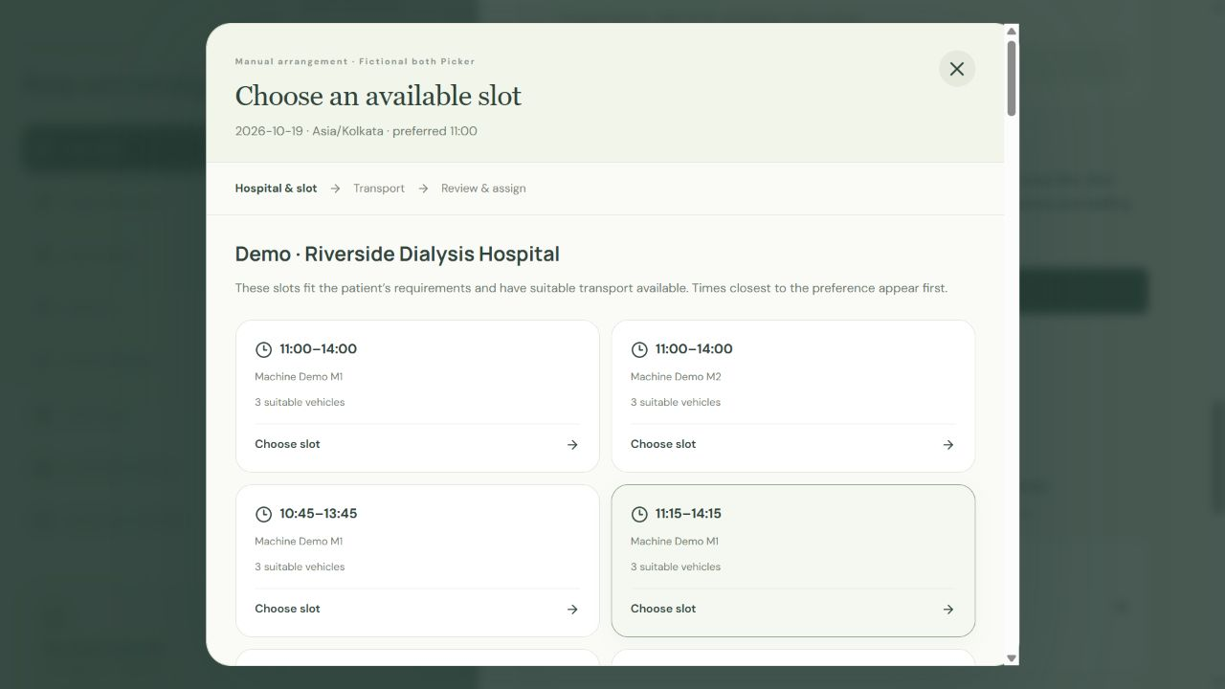
Working Demo / MVP / Interactive Prototype
Manual selection shows eligible slots and transport
A coordinator can compare the available options and approve an exact arrangement.
Choose a hospital
Compare eligible centres in preference-fit order.
Choose the exact slot
Inspect the machine, start time and treatment interval.
Choose suitable transport
Only compatible vehicles remain. Approval rechecks availability.
Actual MVP capture using fictional test records
CareRelay / Baloon National Hackathon 2026 / Round 1
08
Notes:
Image: CareRelay repository docs/assets/manual-hospital-slots.png. Actual earlier isolated browser walkthrough with fictional records. This is software evidence, not a real patient booking or clinical result.

Slide 9
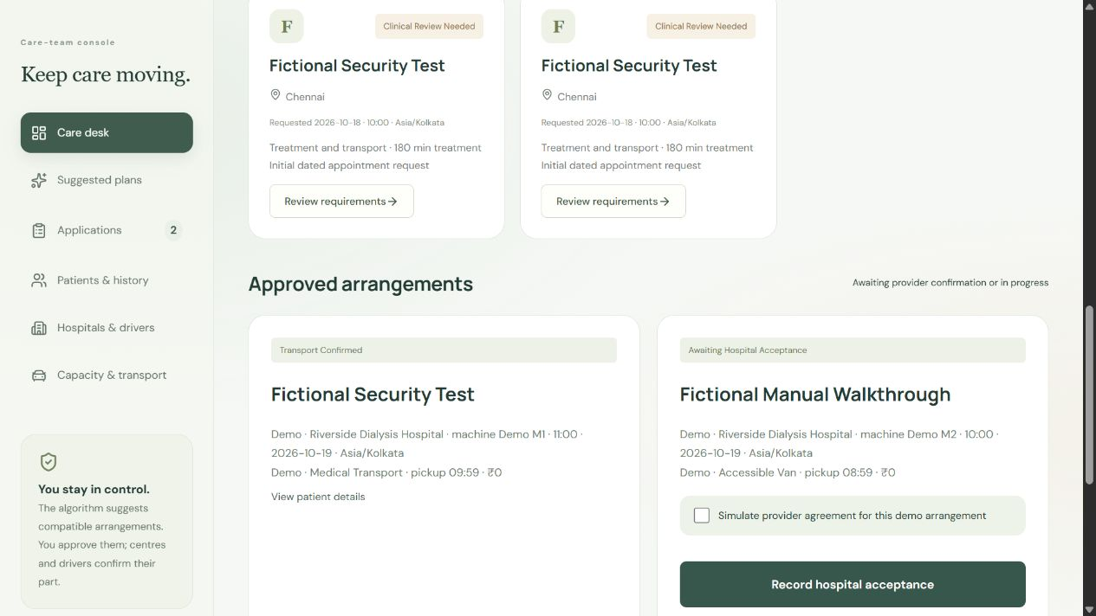
Working Demo / MVP / Interactive Prototype
Suggestions still need approval and confirmation
The care team can approve one suggestion or a compatible group, then obtain provider agreement.
Automatic planning
Generate suggestions against the same feasibility constraints.
Individual or bulk approval
Approve one plan or the proposed group.
Explicit agreement
Record hospital acceptance and driver confirmation separately.
Actual MVP capture of simulated arrangements
CareRelay / Baloon National Hackathon 2026 / Round 1
09
Notes:
Image: docs/assets/demo-arrangements.png. Actual browser walkthrough with fictional test records. Simulated provider agreements are explicitly labelled in the demo.

Slide 10
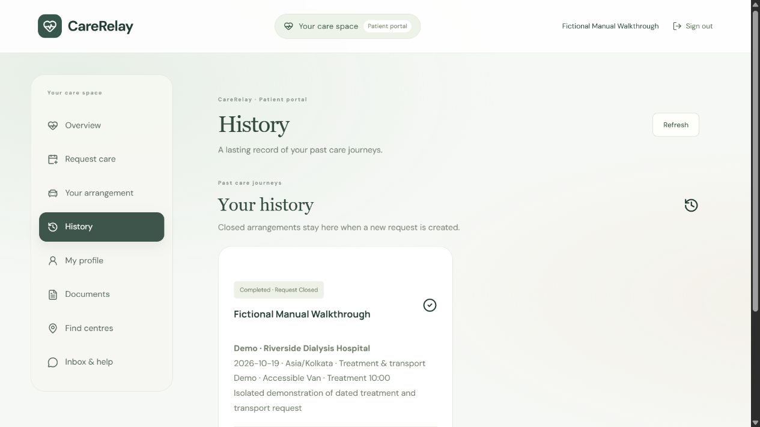
Working Demo / MVP / Interactive Prototype
Completion becomes history, ready for the next request
Patients can report journey milestones after the necessary provider confirmations.
Clear progression
Departure, arrival and treatment progress follow in order.
A closed care episode
Completion clears the active request and retains its snapshot.
Help remains available
Authorized conversations retain replies and unread state.
Actual MVP history using a fictional patient
CareRelay / Baloon National Hackathon 2026 / Round 1
10
Notes:
Image: docs/assets/journey-history.png. Actual isolated browser walkthrough with fictional records. Patient-reported milestones remain distinct from provider confirmation. The screenshot does not represent a clinical outcome.

Slide 11
Feasibility & Expected Impact
Technical evidence supports the MVP scope
Automated checks exercise workflow rules and permissions using isolated fictional data.
91
272
10
Domain tests
Isolated API checks
Manual-picker tests
Timing, eligibility, completion
and relationship rules.
Account access, document isolation,
requests and demo boundaries.
Exact hospital, slot and vehicle
selection, plus conflict rejection.
TypeScript and production build passed. Checks rerun on 20 October 2026.
Software evidence only. No clinical outcome, certification or absence of every defect is claimed.
CareRelay / Baloon National Hackathon 2026 / Round 1
11
Notes:
Repository verification rerun on 20 October 2026: TypeScript, 91 domain tests, 10 manual-picker tests, and the security/API test suite. Final counts on this slide must match the final run. These are software checks, not a claim of clinical validation, complete security, or absence of all defects.

Slide 12
Feasibility & Expected Impact
A supervised pilot is the feasible next step
The MVP proves a software workflow. Real operation would depend on participating providers.
Pilot scope
Operational dependencies
Start with a small local network, verified facility capacity and named transport partners.
Hospitals must keep staffed slots current. Drivers must confirm availability and practical pickup feasibility.
Current technical limits
Before real patient use
Travel times are estimates. INR fares and dated intervals have limits, including no overnight scheduling.
Complete clinical and privacy reviews, vendor agreements, security assessment and operational escalation procedures.
Map coverage alone cannot promise available treatment. The app does not replace emergency care.
CareRelay / Baloon National Hackathon 2026 / Round 1
12
Notes:
Current CareRelay MVP design and repository evidence. Simulated records do not represent real bookings or clinical outcomes.

Slide 13
Feasibility & Expected Impact
Potential impact would be measured, not assumed
The intended benefit is fewer avoidable coordination failures around essential recurring care.
1,000 patients
What a pilot would measure
1,56,000
Time to a confirmed arrangement
Unresolved requests and missed pickups
Patient and caregiver coordination burden
annual treatment visits in an illustrative network
Illustration: 1,000 people × 3 visits weekly × 52 weeks. Schedules vary.
Not an adoption forecast or a result. No reduction in missed sessions or clinical harm has been measured.
CareRelay / Baloon National Hackathon 2026 / Round 1
13
Notes:
Illustration: 1,000 patients × 3 visits weekly × 52 weeks = 156,000 annual visits. Schedule reference: NIDDK, https://www.niddk.nih.gov/health-information/kidney-disease/kidney-failure/choosing-treatment/comparison-chart. Individual prescriptions vary. This is not an adoption forecast or a count of completed or saved appointments. No patient, cost, hospitalisation or lives-saved improvement is claimed.

Slide 14
Feasibility & Expected Impact
A focused path for Round 2 and future expansion
Round 2 would extend the submitted MVP against the organisers’ specific development brief.
Round 2 implementation strategy
Pilot evaluation
Agree acceptance criteria, implement the assigned improvement, then rerun conflict and permission checks.
Measure time to a confirmed arrangement, unresolved requests, missed pickups and patient feedback.
Beyond dialysis
Wider access
Explore chemotherapy, radiotherapy and rehabilitation with service-specific clinical rules.
Add regional languages, caregiver assistance, verified routing and hospital scheduling integrations.
Prototype and judge-demo links are on slide 7. Source access can be provided to authorised reviewers.
CareRelay / Baloon National Hackathon 2026 / Round 1
14
Notes:
Event requirements: supplied Baloon National Hackathon 2026.docx and https://unstop.com/hackathons/baloon-national-hackathon-2026-baloon-1768626 . No official slide-count or branded template was supplied. The four requested sections appear in the prescribed order. No verified past-winner project evidence was found for this specific event, so the deck follows the published evaluation criteria.

